Slide 1
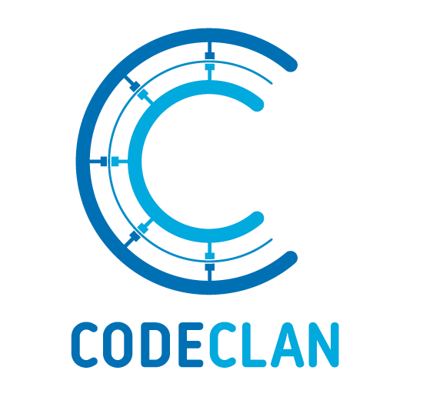
Planning a Software Development Project
SQA Professional Development Award in Software Development

Slide 2
Lesson Objectives
Aim: To help in the preparation and planning of a software development project.
Know a range of techniques that help plan a project.
Understand the importance of good planning.
Be able to produce an effective plan to assist in the development of a software development product.

Slide 3
Where To Start: Project Brief
Build a hub for modern interpretations of classics, e.g. noughts and crosses, tic tac toe. Your app will allow users to register an account to track their interactions. Allow them to start new games which they can play against a friend or the computer. They will be able to see a list of the previous games they have played, and a running score of wins/losses. Maybe even a leaderboard of all players across the site, or the facility to start knockout tournaments.
Notes:
For every project you will get a brief, similar to this one.
This can be a bit vague and doesn’t help us when thinking about where to start.
Being able to break down the requirements of any project will help you prioritise what you need to do.

Slide 4
Where To Start: “gather and prioritise”
Build a hub for modern interpretations of classics, e.g. noughts and crosses, tic tac toe.
Your app will allow users to register an account to track their interactions.
Allow them to start new games which they can play against a friend or the computer.
They will be able to see a list of the previous games they have played, and a running score of wins/losses.
Maybe even a leaderboard of all players across the site, or the facility to start knockout tournaments.
Users
register account
track interactions
Game
start new game
list of previous games
running score of losses/wins
Extra functionality
Leaderboard - all players
Knockout tournaments
Notes:
Breaking down the brief into sentences and then searching through those sentences for the keywords can help.
This should give you your MVP.

Slide 5
Where To Start: MVP
What is an MVP?
Minimal Viable Product
This is the absolute minimum functionality that you must achieve to consider your product viable for production.
From this point, you can build in extra functionality and make it a little more interesting.
Users
register account
track interactions
Game
start new game
list of previous games
running score of losses/wins
Extra functionality
Leaderboard - all players
Knockout tournaments
Notes:
Breaking down your brief will give you your MVP or Minimal Viable Product.
Your MVP is what you should aim to achieve by the end of the week.

Slide 6
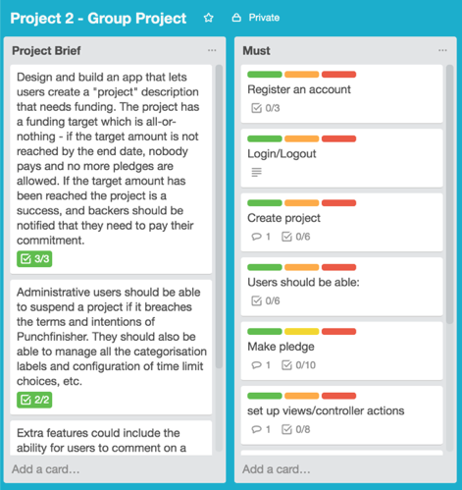
Where To Start: MoSCoW
MoSCoW = Must Should Could Would
MUST be included
SHOULD be included
COULD be included
WOULD be included
Notes:
It can help to break down your product requirements using MoSCoW.
MoSCoW stands for Must, Should, Could, Would.
Must covers your MVP, the stuff you cannot do without. You then prioritise what else you can do from there.

Slide 7
Where To Start: Trello
We can use Trello to record all the information we need for our software development plan.
Labels, checklists, record diagrams by uploading images, multi-user access, etc.
https://trello.com/
Notes:
Trello is a good resource to use to help with this organisation

Slide 8
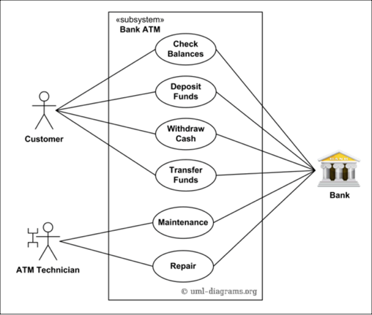
Use Case Diagrams
Use case diagrams give an overview of the usage requirements for a system.
Class diagrams should include:
Use cases - actions that users can perform
Actors - users of the system
Associations - connections between users and the actions
System boundary boxes (optional)

Slide 9
Use Case Diagrams
Create a Use Case Diagram that illustrates a games hub for modern interpretations of classics, e.g. noughts and crosses, tic tac toe.
Users
register account
track interactions
Game
start new game
list of previous games
running score of losses/wins
Extra functionality
Leaderboard - all players
Knockout tournaments

Slide 10
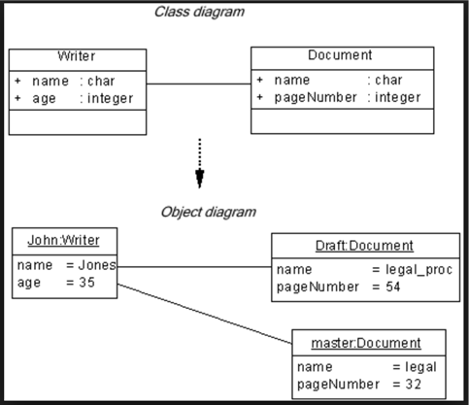
Class Diagrams
Class diagrams describe the structure of a system by showing the system's classes, their attributes, methods and the relationships.
Class diagrams should include:
Name of each class
Attributes of each class
Type of each attribute
Relationships between the classes
Any methods that class has

Slide 11
Object Diagrams
Object diagrams provide examples or act as test cases for class diagrams.
Object diagrams should include:
Name of the class with an instance of that class
Attributes of each class
Type of each attribute replaced with an example of that attribute
Relationships between the classes

Slide 12
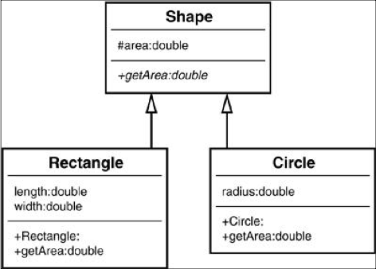
Inheritance Diagrams
An inheritance diagram demonstrates when a child object assumes characteristics of its parent object.
Inheritance diagrams should include:
Relationships between the classes demonstrated using arrows
Focus of the relationships is on the flow of information between the classes
Name of the class
Attributes of each class
Type of each attribute replaced with an example of that attribute

Slide 13
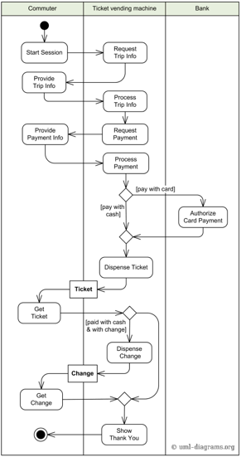
Activity Diagram
An Activity Diagram is a flowchart to represent the flow of information from one activity to another activity.
Before drawing an activity diagram, identify the following elements:
Activities
Association
Conditions
Constraints

Slide 14
Activity Diagram
Activity diagrams should include:
lines with arrows to represent the flow of actions
rounded rectangles to represent actions
diamonds to represent decisions
bars to represent the start (split) or end (join) of concurrent activities
a black circle represents the start (initial state) of the workflow
an encircled black circle represents the end (final state).

Slide 15
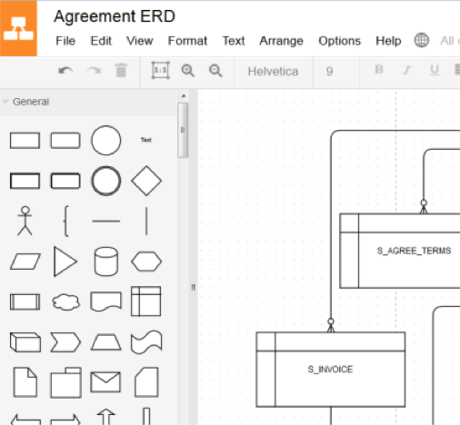
Diagrams: draw.io
Online tool that can help you build class or object diagrams.
Free
Has a lot of built in functionality.
https://www.draw.io/

Slide 16
Implementation Constraints Plan
Implementation constraints are things that might affect the project you are working on, in a broader context.
An implementation constraints plan looks at how these constraints may affect the project and consider how they can be dealt with or counteracted.
The plan usually considers the following constraints:
Hardware and software platforms
Performance requirements
Persistent storage and transactions
Usability
Budgets
Time limitations

Slide 17
Implementation Constraints Plan
Constraint | Possible Effect of Constraint on Product | Solution
Hardware and software platforms
Performance requirements
Persistant storage and transactions
Usability
Budgets
Time limitations

Slide 18
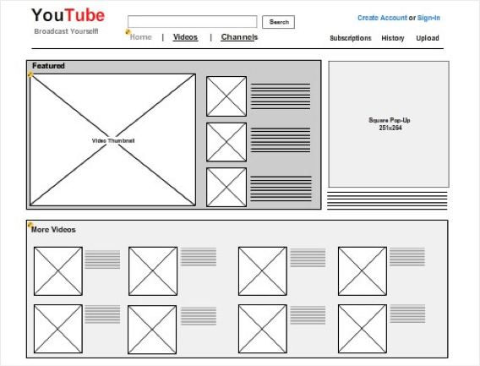
Wireframes
Balsamiq and NinjaMock are software apps that allow you to build wireframes easily.
Balsamic - 30 day free trial
NinjaMock - free

Slide 19
Time Management
Consider about division of labour and time management
Once you have made a plan, that is not the end!Good project management means monitoring progress at all stages of the project
Use AGILE development
- Morning scrums
- End of day re-evaluations

Slide 20
Plan a project
For the project brief, complete the following:
Breakdown the brief and create an MVP.
Create a Use Case Diagram using your MVP.
Create a Class Diagram using your Use Case Diagram.
Build a hub for modern interpretations of classics, e.g. noughts and crosses, tic tac toe. Your app will allow users to register an account to track their interactions. Allow them to start new games which they can play against a friend or the computer. They will be able to see a list of the previous games they have played, and a running score of wins/losses. Maybe even a leaderboard of all players across the site, or the facility to start knockout tournaments.

Slide 21
Planning Your Project
Things you should do to help you plan your project:
Project requirements
Trello and MoSCoW
Wireframes
Time Management
Things you have to do for the PDA:
Use Case Diagrams
Object Diagrams
Class Diagrams
Inheritance Diagrams
Implementation Constraints Plan
Notes:
You do not need to complete all the thing we have discussed every time you plan a project.
However, you do need to plan every time to ensure that you manage your project well.

